Slide 1

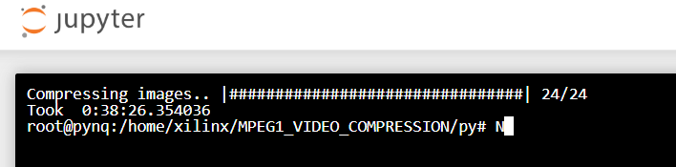
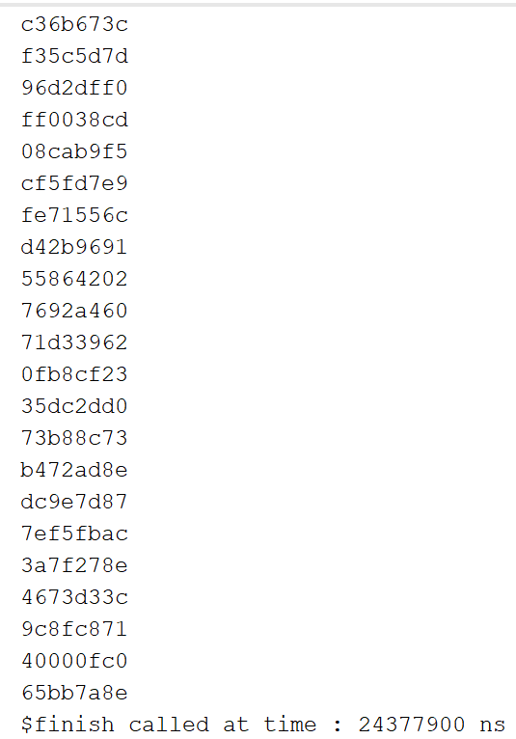
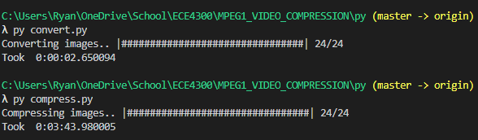
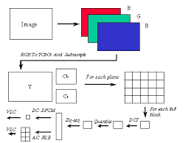
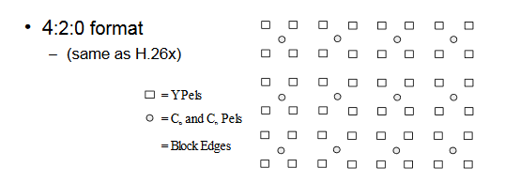
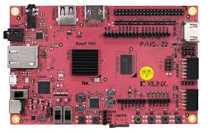

MPEG-1
Douangmanivong, Lucky; White, Ryan; Kim, Jaehyun; Nguyen, Trey; Castro, Jaime; Ly, Eric;
El-Hadedy, Mohamed (ECE 4304/L Professor)
Image Compression Algorithm
INTRODUCTION
EXPERIMENTS
CONCLUSION
We are using software (Python) and hardware (FPGA) in order to perform video compression into MPEG-1 format. Then, we compare the two processes and see which one is faster. This will help us see the differences of software and hardware when performing the same task as well as helping us learn how to implement tasks in hardware and software.
MPEG-1 is a video and audio compression standard that was created in 1992 to compress VHS video and audio. This would allow for VHS media to be put on more platforms such as cable TV and video CDs. The MPEG-1 format would compress the video and audio to around 1.5 Mbits/s which allows for these products to be used in a large amount of products. MPEG-1 is still a popular format today and is widely known for popularizing the MP3 audio format. This compression format was also extended to MPEG-2, MPEG-3, etc.
Experiments were conducted by first ensuring that we had a baseline to compare our hardware implementation against. This involved the creation/acquisition of Python code that would compress a series of 24 frames to compress as I-Frames. We then ran the Python code on a PC and used its run time of 3 minutes as the baseline.
The next step in our experiment was to implement the same code onto the Pynq board and see how long it would take to run the code on the FPGA. After deploying the code on the chip, we acquired a run time of about 38 minutes.
Finally our last metric to be measured is the runtime for the actual hardware implementation of the I-Frame encoding. After testing we acquired a 33 minute runtime to run the simulation, with 12 minutes of actual cpu time. The Simulation end time was about 0.024 seconds which means that the theoretical time to encode all of the frames is significantly faster than the python code.
In conclusion, the motivation of this project was to demonstrate understanding of both software and hardware performance metrics by implementing the MPEG -1 standard of video compression. We did this by first implementing a python code to compress I-frames and ran it on both a PC and a PYNQ Z1 FPGA. When comparing both systems, the PC greatly outperformed the PYNQ board due to the PC’s more robust processor. This performance imbalance quickly changed when we started phase 2 of our testing which was to attempt to implement a purely hardware version of the compressor by deploying verilog code on the board. We were unsuccessful at fully deploying the code; however, we were able to acquire theoretical metrics from utilizing a test bench. From the Verilog testbench, we acquired a theoretical execution time that was shorter than that of the PC run Python code. This increase in performance demonstrated the viability of using hardware to accelerate specific jobs within a system.
DESIGN
RESULTS
The creation and implementation of MPEG-1 Image Compression Algorithms may seem complex, but can be broken down into a set of smaller processes that need to be completed. The very first that needs to be done is to convert the RGB values, which is what the CPU sees to display frames of a video, into YCbCr values. This color space of Luma, Chroma Blue, and Chroma Red is used widely in video systems. For consumers, this is the color space that is commonly referred to. Many Video Compression Algorithms are based on the H.261 standard of using reference frames to forward predict, but MPEG-1 uses future frames as backward prediction.
The next step in MPEG-1 Video Compression Algorithms is to apply a Discrete Cosine Transform (DCT) to an 8x8 block of uncompressed pixel values. First, a Forward Discrete Cosine Transform converts the uncompressed block into an indexed array of frequency coefficient values. These coefficient values are then quantized by dividing them by a larger step size and rounding to an integer value. Again, a quantization matrix is created as a result, which tells the encoder how important each piece of visual information is. Each value in the matrix then corresponds to a certain frequency component of the compressed video image.
After the 8x8 matrix is quantized by the DCT algorithm, a zig-zag scan is performed on the matrix to generate a bitstream of data that will be encoded with run length encoding (RLE). This method of encoding creates a method with which the system skips the zeros found within the bitstream and signals to the system where the next significant value is located which reduces the size of the data.
AREAS OF IMPROVEMENT
Speed for both hardware and software
Enhancing code for further use
Improve efficiency of the FPGA
FUTURE WORK
For future work, we decided that we could improve the code for both hardware and software in order to make it run more smoothly and efficiently. We also could have enhanced the code to be used for other operations such as the extended MPEG-2 and MPEG-4 formats to compare the run times and emphasize the improvements from one to the other. Another area for future work would be implementing the Verilog code on the board which would be done by creating ROMS with frames for storage and creating UART serial communication to stream the RGB values. Another area of improvement for this project would have been to manage our efforts better and have more consistent communication between group members, as that is always an area that everyone can work on.
HW/SW Materials
Xilinx Pynq-z1 FPGA board
Laptop (Microsoft Surface Book 2)
Micro-USB to USB cable
Xilinx Vivado 2019 (VHDL Language)
Microsoft Visual Studio 2019
Microsoft Word, Powerpoint
ACKNOWLEDGEMENTS
We would like to acknowledge xilinx for allowing use to use the Pynq-z1 FPGAs to develop and test this project on MPEG-1 Image Compression. We would also like to thank our professor, Dr. Mohamed El-Hadedy for constant support and guidance.
Figure 4. HW/SW Materials

